Slide 1

Collaborative Android Apps
Michael L Perry
With Correspondence

Slide 2
Follow Along
github.com/MichaelLPerry/CorrespondenceAndroid

Slide 3

Collaborative Apps
Personal data
Accessible from other devices
Shared with other people
Notes:
http://www.guardian.co.uk/technology/blog/2010/jul/12/geolocation-foursquare-gowalla-privacy-concerns

Slide 4
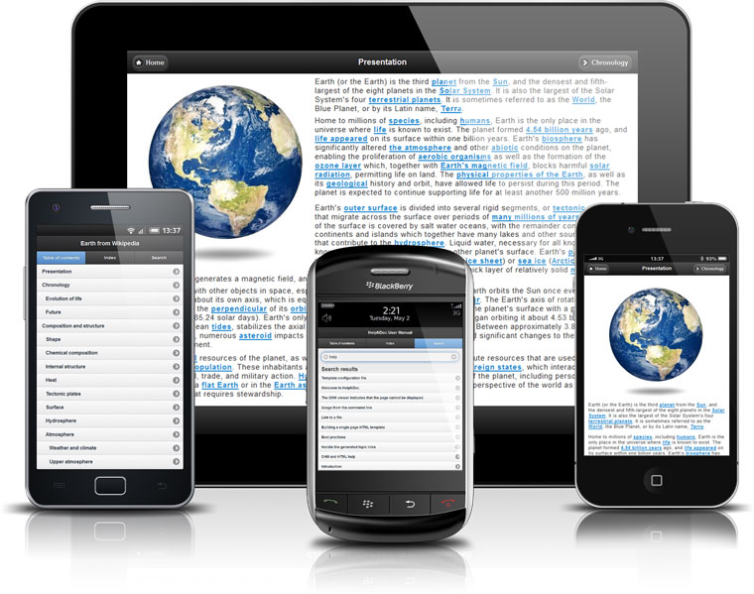
Web
Build it once
Broad reach
Notes:
http://www.helpndoc.com/news/2011-12-08-generate-touch-optimized-documentation-jquery-mobile-framework

Slide 5
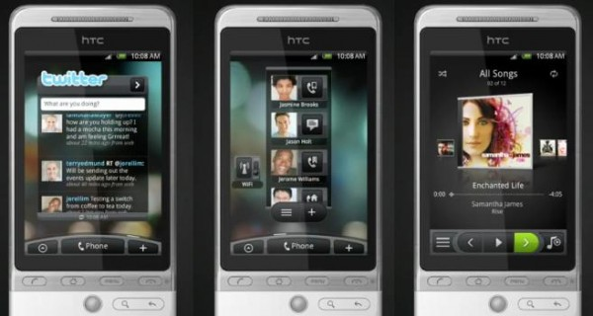
Native
Responsive
Platform integration
Works offline
Rich UI
Notes:
http://techcrunch.com/2012/06/07/facebooks-dilemma-with-native-ios-apps-relevance-or-revenues/

Slide 6
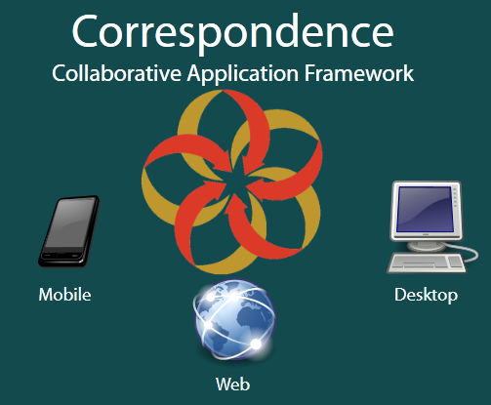
Multi-Platform
Android
Web Content
Windows Phone
Windows Presentation Foundation

Slide 7
Historical Facts
Individual
List
Share
Task
Task Text
Task Complete
Task Complete Undo

Slide 8
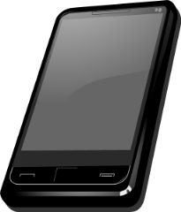

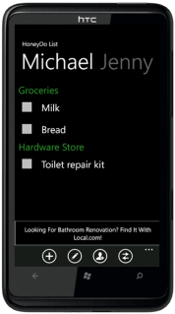
Distributed

Slide 9
Merged Models
Facts are not destroyed
Facts are not changed
Event stream
Publish/subscribe
Eventually consistent

Slide 10
Correspondence
Factual modeling language
Publish/subscribe
Adapters

Slide 11
Factual Modeling Language
fact List {
key:
string identifier;
query:
Task* tasks {
Task t : t.list = this
where not t.isComplete
}
}
fact Task {
key:
unique;
publish List list
where not this.isComplete;
time created;
query:
bool isComplete {
exists TaskComplete c : c.task = this
where not c.isUndone
}
}

Slide 12
Correspondence
Factual modeling language
Publish/subscribe
Adapters

Slide 13
Publish
Individual
List
Share
Task
fact Share {
key:
unique;
publish Individual individual;
List list;
}
fact Task {
key:
unique;
publish List list
where not this.isComplete;
time created;
}

Slide 14
Subscribe
Individual
List
Share
Task
public Iterable<CorrespondenceFact> getSubscriptions() {
ArrayList<CorrespondenceFact> subscriptions =
new ArrayList<CorrespondenceFact>();
subscriptions.add(individual);
subscriptions.addAll(individual.sharedLists());
return subscriptions;
}

Slide 15
Correspondence
Factual modeling language
Publish/subscribe
Adapters

Slide 16
Adapters
Update when necessary
Track dependencies
Refresh UI
Capture user input

Slide 17
Update When Necessary
depListSummaries = Update.whenNecessary(new UpdateAdapter() {
public void update() {
updateListSummaries();
}
public void assign() {
assignListSummaries();
}
});
Update method to track dependencies.
Assign method to refresh UI.

Slide 18
Track Dependencies
private void updateListSummaries() {
taskAdapters = new ArrayList<TaskAdapter>();
for (Task task : list.tasks()) {
taskAdapters.add(new TaskAdapter(task, context));
}
}
When list.tasks() changes, update is re-executed.

Slide 19
Refresh UI
private void assignListSummaries() {
this.clear();
for (TaskAdapter taskAdapter : taskAdapters) {
this.add(taskAdapter);
}
}
Executed after each update.

Slide 20
Capture User Input
private void setTaskCompleted(boolean isChecked) {
if (isChecked) {
task.getCommunity().addFact(new TaskComplete(task));
}
else {
for (TaskComplete taskComplete : task.complete()) {
taskComplete.getCommunity().addFact(
new TaskCompleteUndo(taskComplete));
}
}
}
Every change is a new fact.

Slide 21
Correspondence
Factual modeling language
Publish/subscribe
Adapters

Slide 22
Next Steps
CorrespondenceCloud.com
Fork the code
Get an API key
Build your own collaborative app

